Slide 1

DXC Digital Explorer 101
https://digitalexplorer.dxc.com
Industry, technology, client roadmaps and solution knowledge combined
David Stevens Digital Explorer Product Owner & Architect
DXC Workplace group

Slide 2

Introduction
David Stevens
DXC Distinguished Architect Technology Transformation Lead DXC Technology Office
Creator, Product Owner and Architect for Digital Explorer

Slide 3
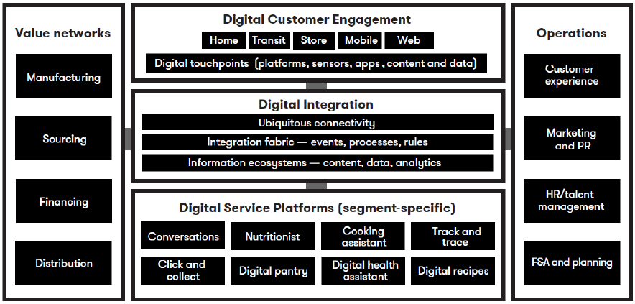
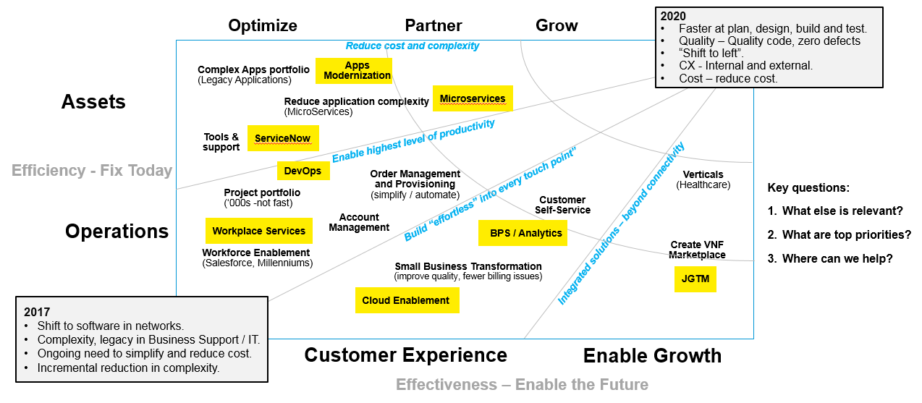

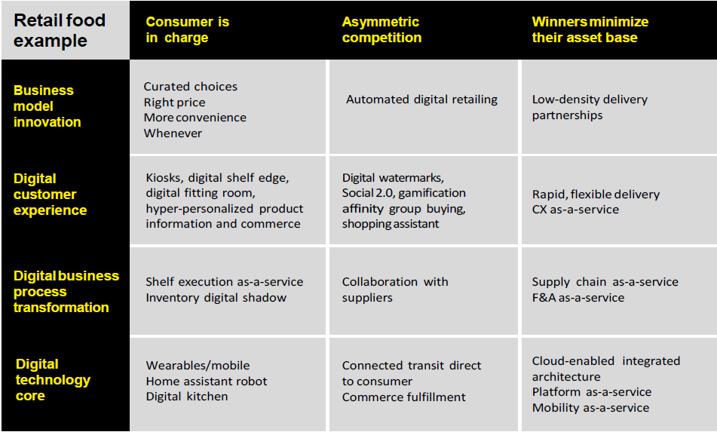
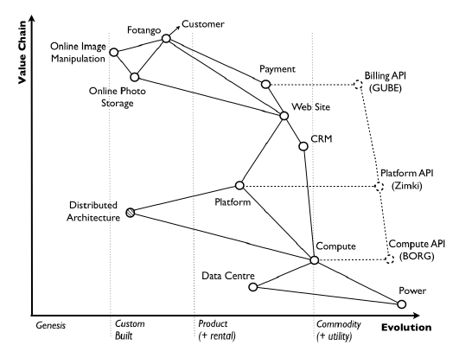
Digital Dynamics – ‘Strategy Sprints’ to an Actionable Plan
Model ‘logic’ for client engagement, account and sales planning
DIGITAL RELEVANCE
DIGITAL INTENT
CAPABILITY NEEDS
ROUTE TO VALUE
Why is digital relevant and what value is anticipated?
What are the options and what do we intend to do?
What capabilities are needed to deliver expected value?
What change roadmap leads to value realisation?
ACTIONABLE PLAN
Digital Business Agenda
Context and Options
Readiness / Capability Gaps
Roadmap and Value Impact
Business Discovery
Initiate
THINK
DESIGN
DELIVER

Slide 4
Introduction Sessions
Digital Explorer 101 :
Introduction to the platform
How to use Digital Explorer to support your post Bootcamp 1 activities
Trends
The model
How to navigate the information
What can you learn about trends?
Finding solutions
Workspaces
Digital Explorer 201 :
Innovation Agendas
Digital Explorer 301 : Collaboration

Slide 5




Understand
Shape
Build
Harvest
Offerings
Disruptor
Solution
Industry
Trend
Value Chain
Client Innovation Agenda
Goal
Client CMO
Technology
Enabler
Enabler
Partners
Notes:
Slide steps through
1. First we need to understand the business drivers and industry direction
2. Through innovation agenda’s and other client discussions we take these and shape against the client’s key strategic programs
3. The agendas call out opportunities for DXC to build solutions for (offerings plus, partners)
4. Solutions are captured and help support the next person following this common path

Slide 6
Understand
Shape
Build
Harvest
Offerings
Disruptor
Solution
Industry
Trend
Value Chain
Client Innovation Agenda
Goal
Client CMO
Technology
Enabler
Enabler
Partners
Notes:
This approach is common for all our account leadership teams

Slide 7
Notes:
And is repeated EVERYWHERE

Slide 8
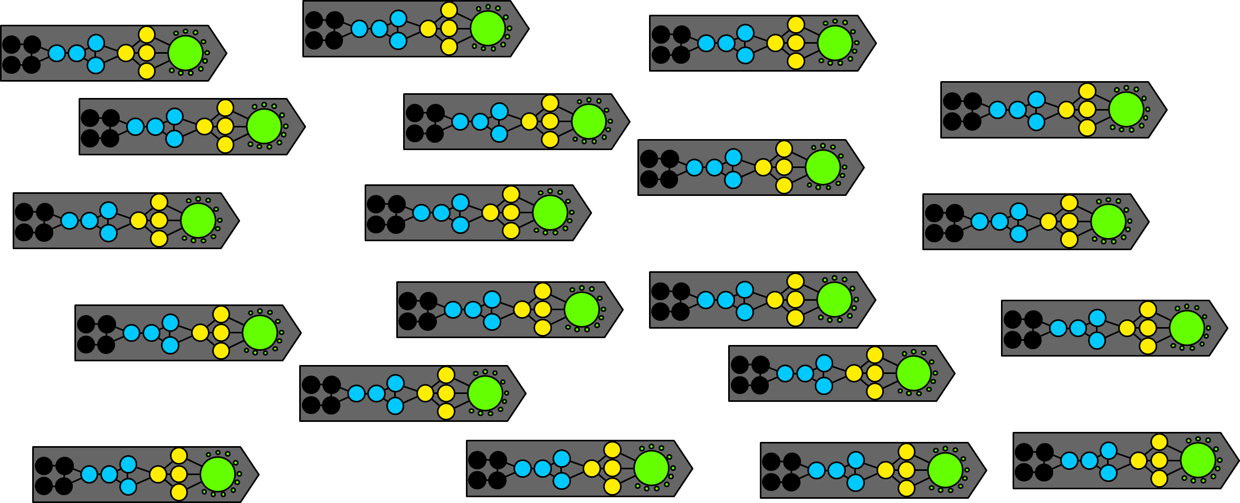
Notes:
Digital Explorer helps connect all these key steps together.
We can all learn and share industry knowledge
We can all understand true client demand and direction
We can work as a single organisation to address the unmet demands
Our Build teams can gain insights into future demand – prep our offerings, people and processes to meet the new demands

Slide 9
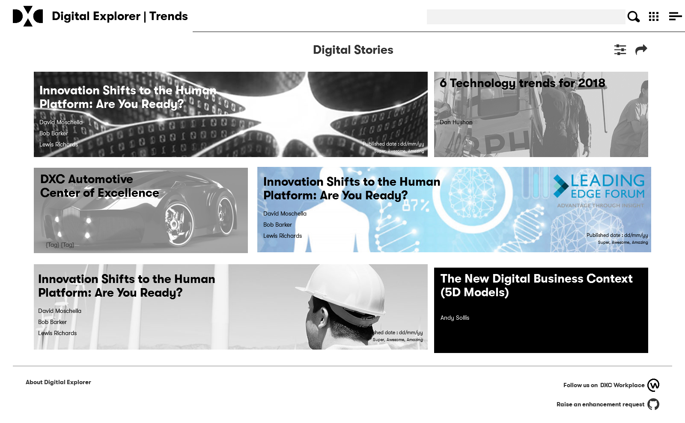
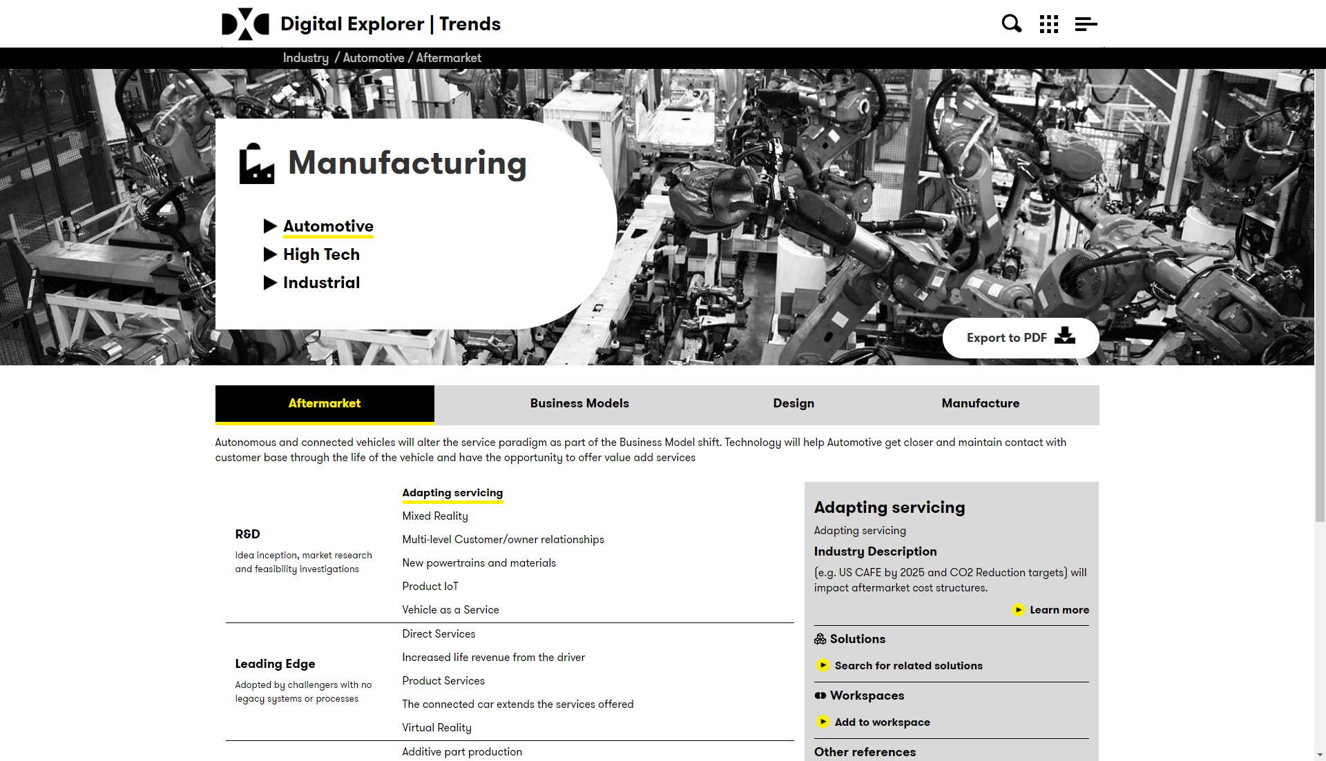
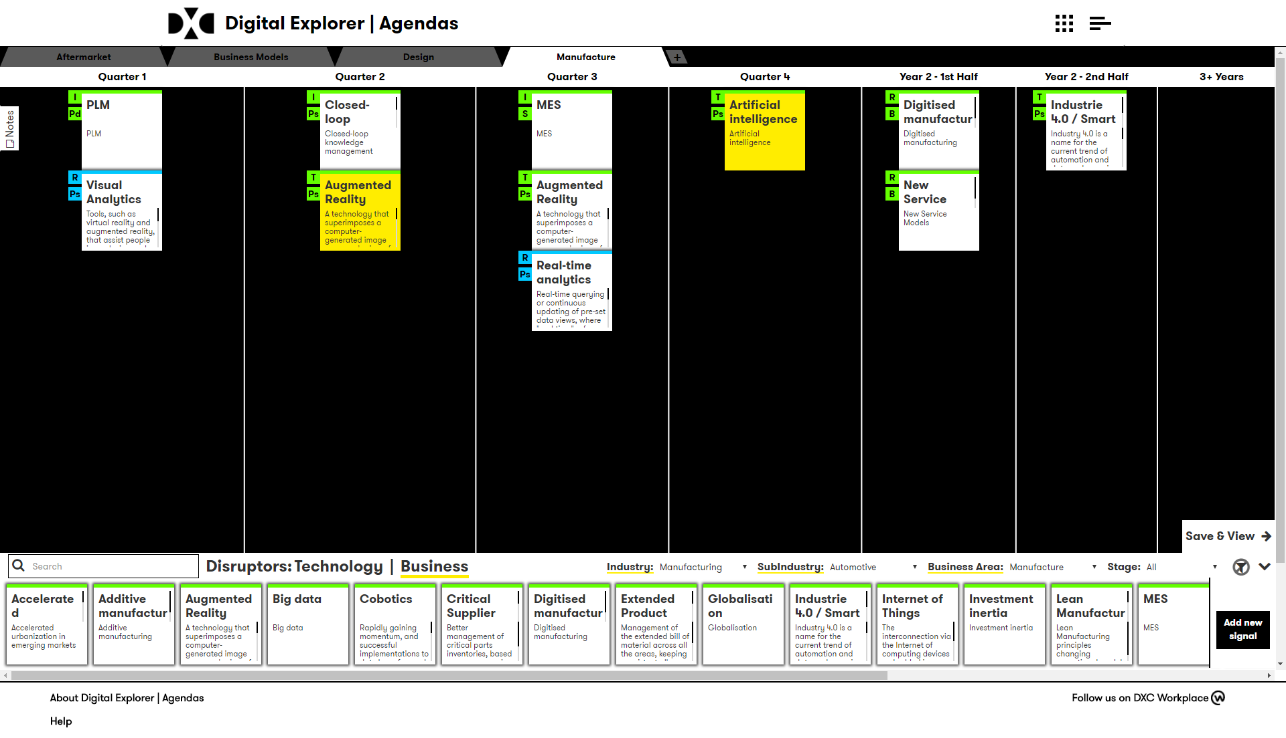
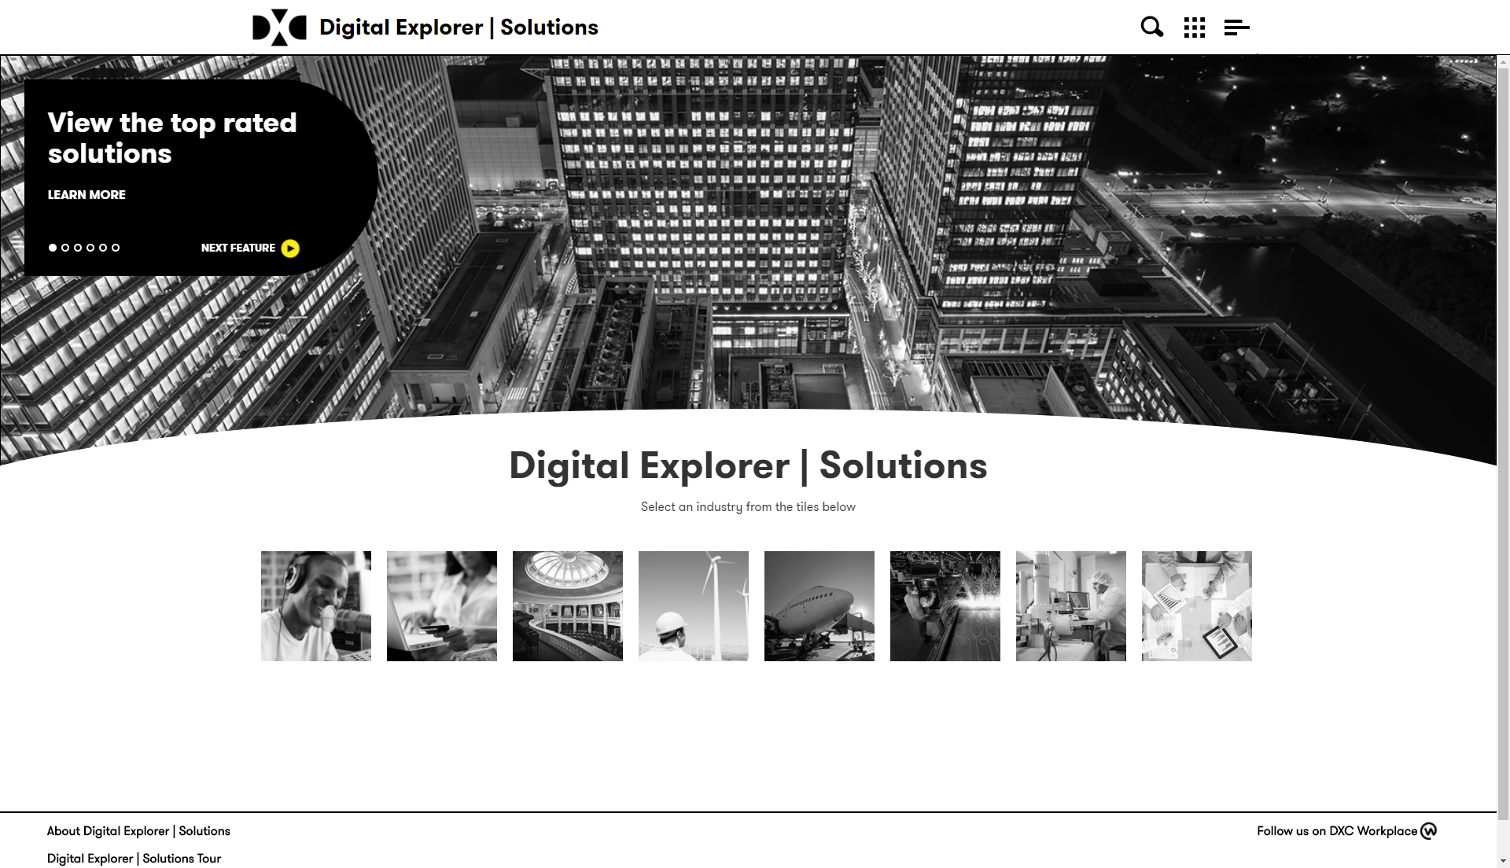

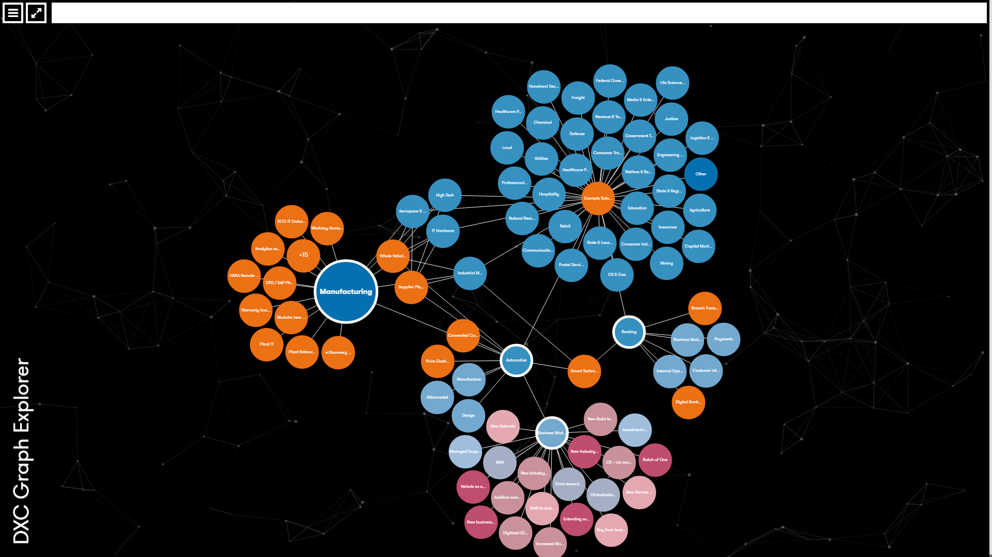
Digital Explorer
101
Digital Explorer | Stories
Digital Explorer | Trends
Digital Explorer | Agendas
Digital Explorer | Solutions
Digital Explorer | Workspaces
101
Understand
201
Shape
101 201
Deliver
DXC Knowledge Graph

Slide 10
Industry Trends The Digital Explorer information model
Industry
Sub Industry
Sub Industry
Business Area
Business Area
Business Area
Business Area
Business Area
Business Area
Business Area
Business Area
Industry Use Case & Maturity
Industry Use Case & Maturity
Industry Use Case & Maturity
Industry Use Case & Maturity
Industry Use Case & Maturity
Industry Use Case & Maturity
Industry Use Case & Maturity
Industry Use Case & Maturity
Trend
Trend
Trend
Trend
Trend
Trend
Trend
Trend
Trend
Trend
Trend
Trend

Slide 11
Industry Trends The Digital Explorer information model – Example
Manufacturing
Consumer Industries & Retail
Automotive
High-tech
Retail
Business Models
Design
Manufacturing
Aftermarket
Business Models
Design
Manufacturing
Aftermarket
Business Models
Customer Experience
Supply Chain
People & Assets
Industry Use Case & Maturity
Industry Use Case & Maturity
Industry Use Case & Maturity
Industry Use Case & Maturity
Trend

Slide 12
Industry Trends & Solutions
Manufacturing
Consumer Industries & Retail
Automotive
High-tech
Retail
Business Models
Design
Manufacturing
Aftermarket
Business Models
Design
Manufacturing
Aftermarket
Business Models
Customer Experience
Supply Chain
People & Assets
People
People
People
Industry Use Case & Maturity
Industry Use Case & Maturity
Industry Use Case & Maturity
Industry Use Case & Maturity
People
Trend
Solution
Solution
Solution
Solution
People
People
People
People

Slide 13
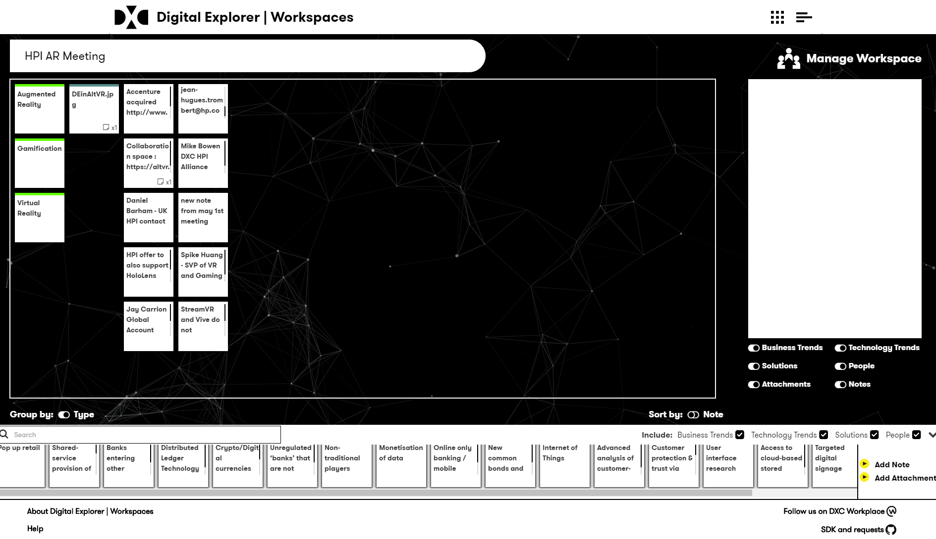
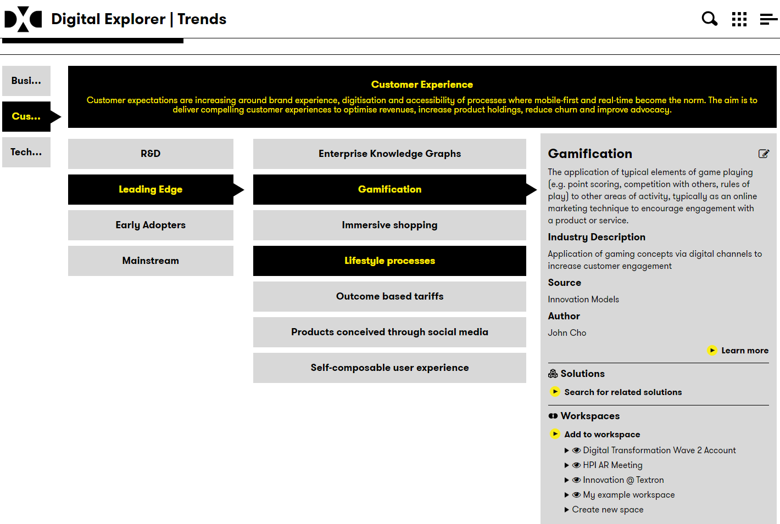
Your Digital Workspace
Login with your Global Pass ID
You can save trends, solutions and other documents into your team’s Digital Workspace
Add team members, notes and other content

Slide 14
DEMO

Slide 15




Learn More, Join the conversation, become part of the team
video.dxc
Introduction videos
Detailed videos for each module
Did you know quick guides
Release notes and videos
General discussions
SDK (datamodel, API’s, sandbox details)
Enhancement requests
Defects
video.dxc
Workplace
GitHub

